Slide 1
Supply Chain Analysis
File created on: 1/2/2025 2:43:48 PM

Slide 2
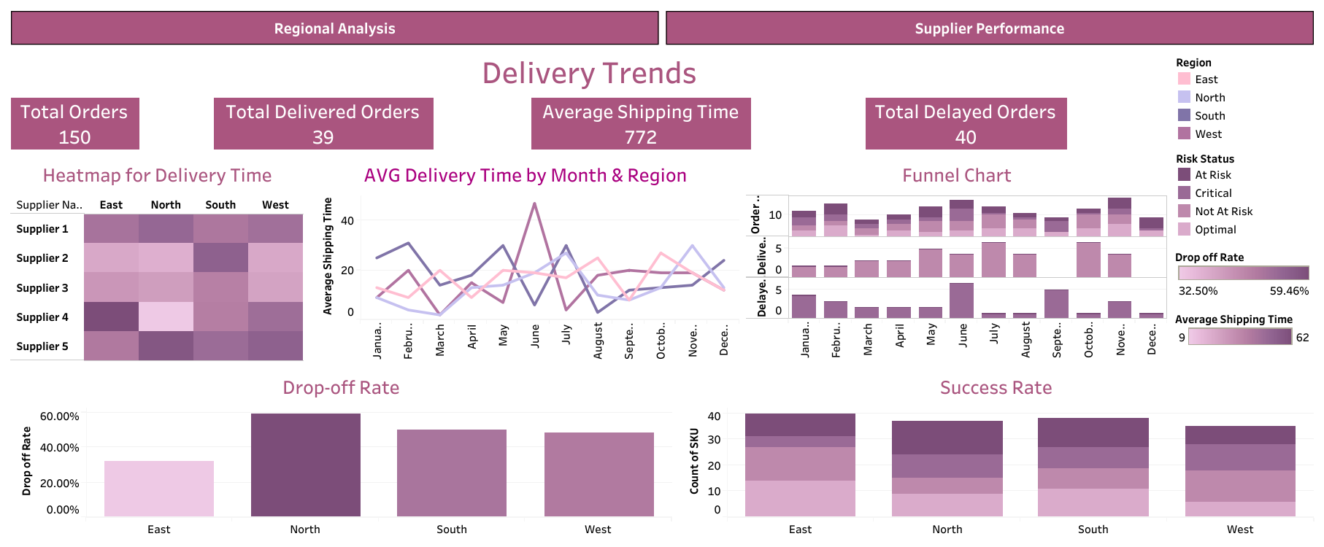

Slide 3
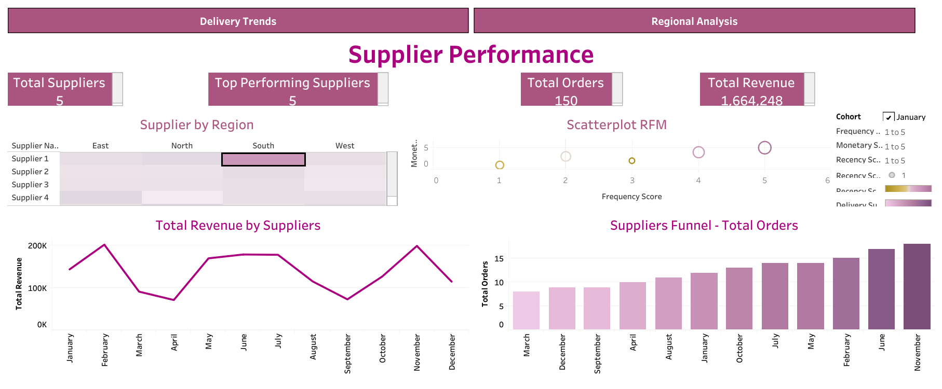

Slide 4
